Slide 1
Engineering Economy
Chapter 3: Cost Estimation Techniques

Slide 2
The objective of Chapter 3 is to present various methods for estimating important factors in an engineering economy study.

Slide 3
Estimating the future cash flows for feasible alternatives is a critical step in engineering economy studies. Estimating costs, revenues, useful lives, residual values, and other pertinent data can be the most difficult, expensive, and time-consuming part of the study.

Slide 4
Results of cost estimating are used for a variety of purposes.
Setting selling prices for quoting, bidding, or evaluating contracts.
Determining if a proposed product can be made and distributed at a profit.
Evaluating how much capital can be justified for changes and improvements.
Setting benchmarks for productivity improvement programs.

Slide 5
The two fundamental approaches are “top-down” and “bottom-up.”
Top-down uses historical data from similar projects. It is best used when alternatives are still being developed and refined.
Bottom-up is more detailed and works best when the detail concerning the desired output (product or service) has been defined and clarified.

Slide 6
The integrated cost estimation approach has three major components.
Work breakdown structure (WBS)
Cost and revenue structure (classification)
Estimating techniques (models)

Slide 7
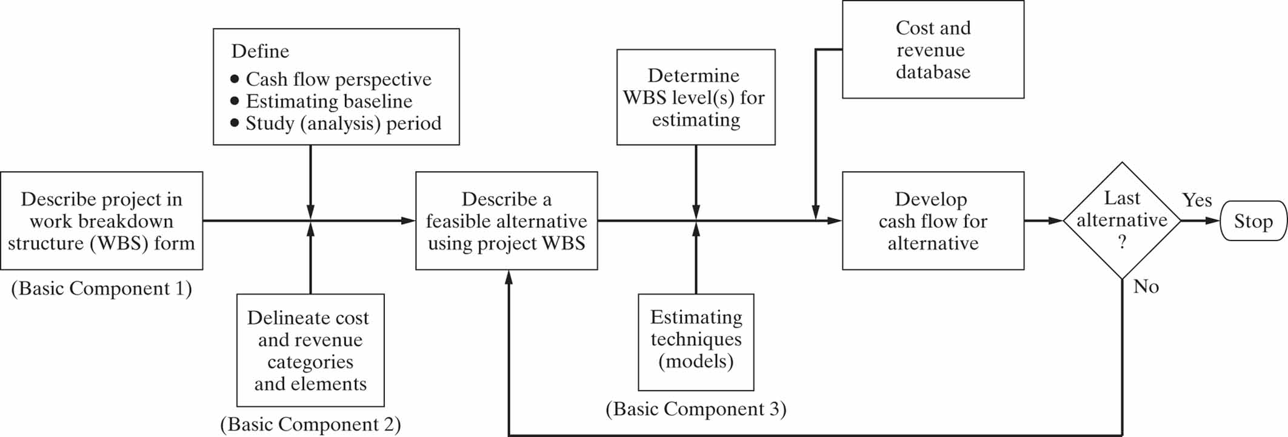

Slide 8
Work Breakdown Structure (WBS)
A basic tool in project management
A framework for defining all project work elements and their relationships, collecting and organizing information, developing relevant cost and revenue data, and management activities.
Each level of a WBS divides the work elements into increasing detail.

Slide 9
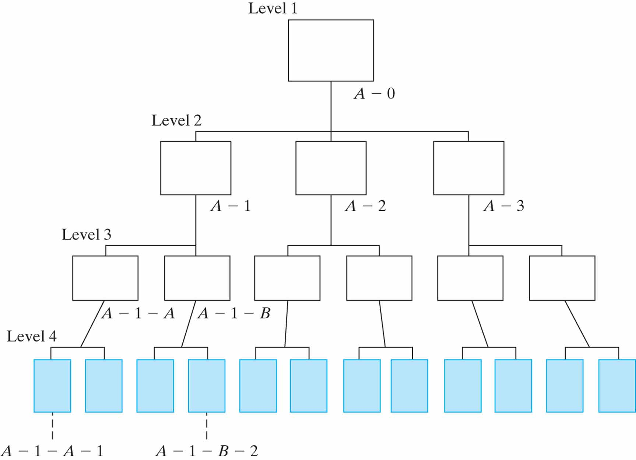

Slide 10
A WBS has other characteristics.
Both functional and physical work elements are included.
The content and resource requirements for a work element are the sum of the activities and resources of related subelements below it.
A project WBS usually includes recurring and nonrecurring work elements.

Slide 11
Cost and Revenue Structure
Used to identify and categorize the costs and revenues that need to be included in the analysis.
The life-cycle concept and WBS are important aids in developing the cost and revenue structure for a project.
Perhaps the most serious source of errors in developing cash flows is overlooking important categories of costs and revenues.

Slide 12
Estimating Techniques
REMEMBER! The purpose of estimating is to develop cash-flow projections—not to produce exact data about the future, which is virtually impossible. Cost and revenue estimates can be classified according to detail, accuracy, and their intended use.
Order-of-magnitude estimates (±30%)
Semidetailed, or budget, estimates (±15%)
Definitive (detailed) estimates (±5%)

Slide 13
The level of detail and accuracy of estimates depends on
time and effort available as justified by the importance of the study,
difficulty of estimating the items in question,
methods or techniques employed,
qualifications of the estimator(s), and
sensitivity of study results to particular factor estimates.

Slide 14
A variety of sources exist for cost and revenue estimation.
Accounting records: good for historical data, but limited for engineering economic analysis.
Other sources inside the firm: e.g., sales, engineering, production, purchasing.
Sources outside the firm: U.S. government data, industry surveys, trade journals, and personal contacts.
Research and development: e.g., pilot plant, test marketing program, surveys.

Slide 15
These models can be used in many types of estimates.
Indexes
Unit technique
Factor technique

Slide 16
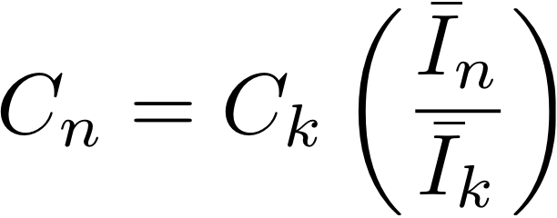
Indexes, I, provide a means for developing present and future cost and price estimates from historical data.
k = reference year for which cost or price is known.
n = year for which cost or price is to be estimated (n>k).
C_{n} = estimated cost or price of item in year n.
C_{k} = cost or price of item in reference year k.
Indexes can be created for a single item or for multiple items.

Slide 17
The unit technique is one that is widely known and understood.
A “per unit factor” is used, along with the appropriate number of units, to find the total estimate of cost. An often used example is the cost of a particular house. Using a per unit factor of, say, $120 per square foot, and applying that to a house with 3,000 square feet, results in an estimated cost of $120 x 3,000 = $360,000.
This techniques is useful in preliminary estimates, but using average costs can be very misleading.

Slide 18
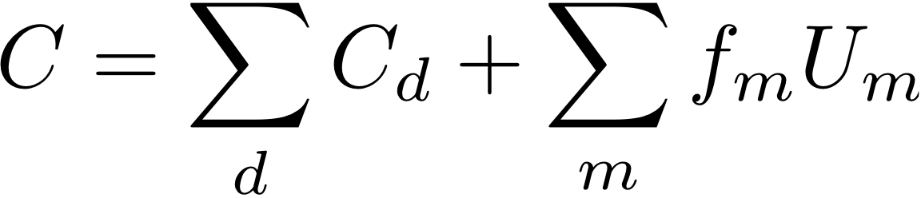
The factor technique is an extension of the unit technique where the products of several quantities are summed and then added to components estimated directly.
C = cost being estimated
C_{d} = cost of the selected component d estimated directly
f_{m} = cost per unit of component m
U_{m} = number of units of component m

Slide 19
Parametric cost estimating is the use of historical cost data and statistical techniques (e.g., linear regression) to predict future costs. Parametric models are used in the early design stages to get an idea of how much the product (or project) will cost, on the basis of a few physical attributes (such as weight, volume, and power).

Slide 20
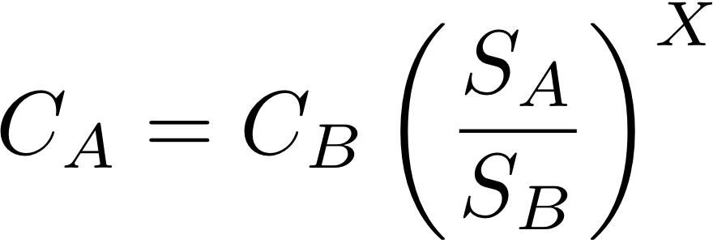
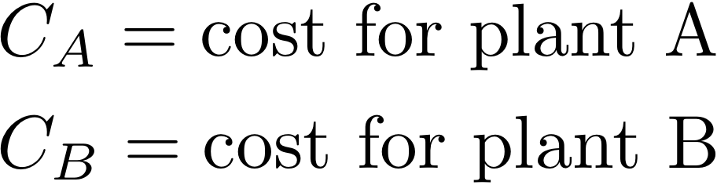
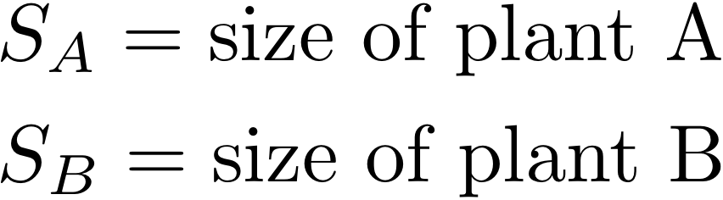
The power-sizing technique (or exponential model) is frequently used for developing capital investment estimates for industrial plants and equipment.
(both in $ as of the point in time for which the estimate is desired)
(both in the same physical units)

Slide 21
A learning curve reflects increased efficiency and performance with repetitive production of a good or service. The concept is that some input resources decrease, on a per-output-unit basis, as the number of units produced increases.

Slide 22
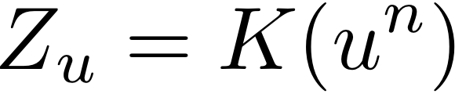
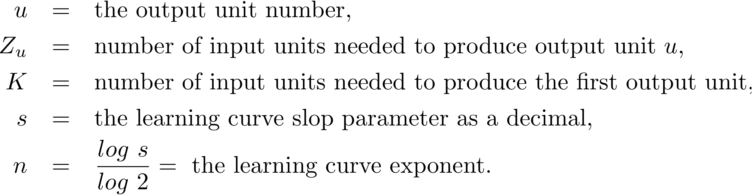
Most learning curves assume a constant percentage reduction occurs as the number of units produced is doubled.

Slide 23
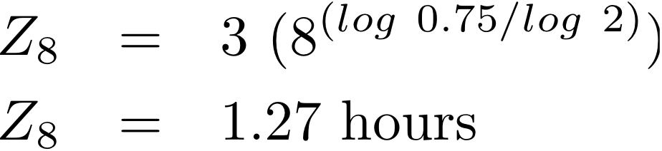
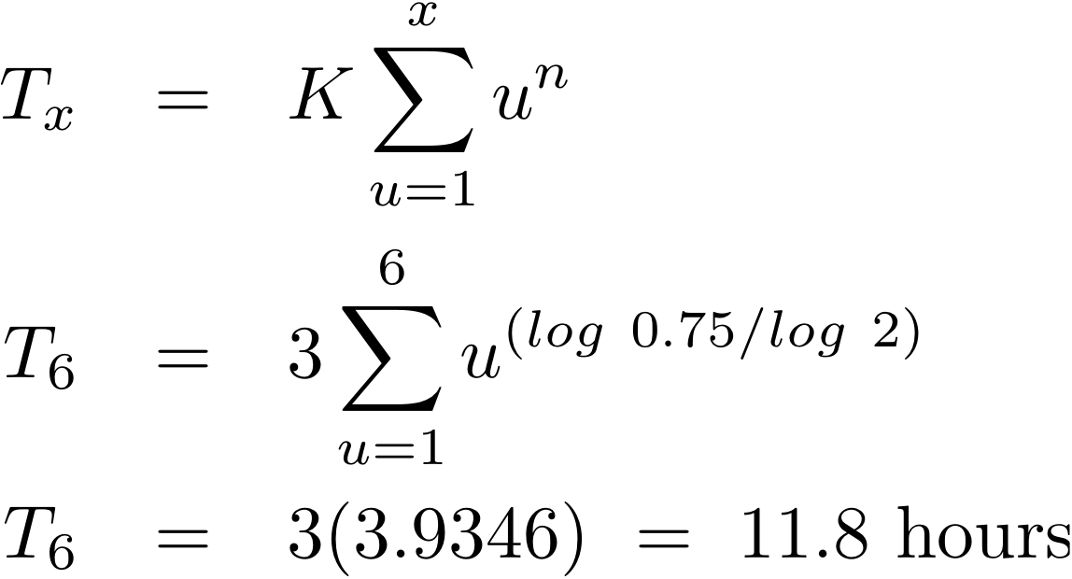
Learning curve example: Assume the first unit of production required 3 hours time for assembly. The learning rate is 75%. Find (a) the time to assemble the 8th unit, and (b) the time needed to assemble the first 6 units.

Slide 24
A cost estimating relationship (CER) describes the cost of a project as a function of design variables.
There are four basic steps in developing a CER.
Problem definition
Data collection and normalization
CER equation development
Model validation and documentation

Slide 25
“Bottom-up” cost estimating is commonly used to make decisions about what to produce and how to price products.
Major types of costs to estimate are
tooling costs,
manufacturing labor costs,
material costs,
supervision,
factory overhead, and
general and administrative costs.

Slide 26
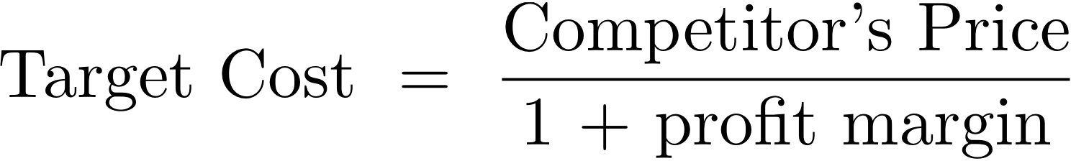
“Top-down,” or target costing, focuses on “what should the product cost” instead of “what does the product cost,” with the aim of designing costs out of products before they enter the manufacturing process. Costs are viewed as an input to the design process.
or

Slide 27
The objective of value engineering (VE) is to provide required product fundtions at a minimum cost. Below are some sample VE questions than should be asked.
Are all the functions provided required by the customer?
Can less expensive material be used?
Can the number of different materials used be reduced?
Can fewer parts be used?
Are all the machined parts necessary?
Would product redesign eliminate quality problems?
Is the current level of packaging necessary?
Can a part designed for another product be used?

